Slide 1
Welcome to CS 212

Slide 2
Course Websites
Canvas (now at canvas.Humboldt.edu) is the central hub for the course
Github (https://github.com/acarteas/Teaching-Algorithms/) will be used to store all course materials: course syllabus, official calendar, assignment descriptions, and other course documents

Slide 3
Textbook: Cormen et al. - Introduction to Algorithms (3rd edition)
Free through HSU library (see syllabus for link)
Used for $60.
2nd edition will probably work; less than $20 on Amazon

Slide 4

Other Recommended Reading

Slide 5
I will be periodically asking "clicker" questions in the course
Turning point subscription not required

Slide 6
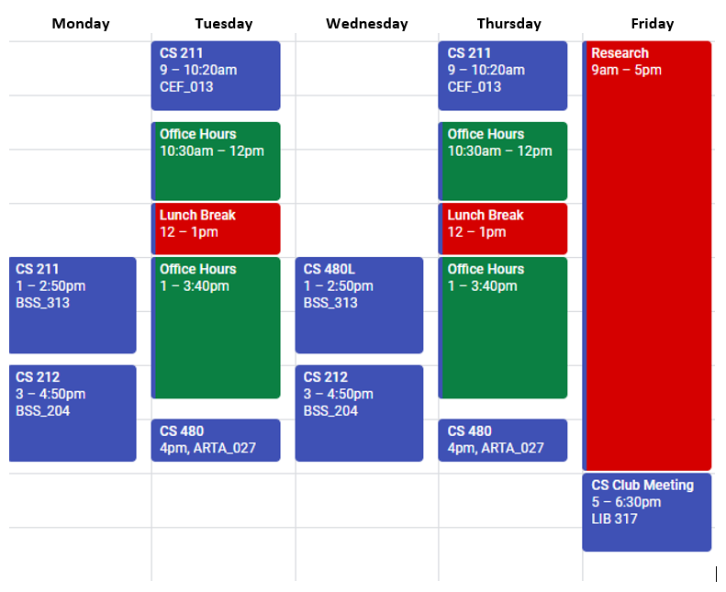
Adam’s Schedule

Slide 7
Programming Environments
I encourage you to use an IDE when working on your solutions. My preference for IDEs are:
Visual Studio 2017 (community edition is free for everyone; enterprise is free for HSU CS Majors!)
JetBrains CLion
Netbeans 8.1 (Be sure you're in C++ 11 or C++ 14 mode!)
CodeBlocks (Be sure you're in C++ 11 or C++ 14 mode!)
I prefer VS 2017 because it has the best and easiest to use debugging capabilities.

Slide 8
Homework Policy
40 HW “bonus” points
All homework must be submitted by the due date
No "late" turn-ins
"Late" is somewhat floating
"Late" means the time after whenever I pull your code from canvas
Thus, 12:01 AM is not considered late
I usually pull code mid morning after a due date (e.g. around 10AM), but sometimes I forget to pull the code until much later.
Takeaway: Try to have the code in by the true deadline, but if it's a few hours late you're probably fine.

Slide 9
A Note on Cheating
Don't do it!
See syllabus for examples of cheating.
I usually catch at least one cheater per semester. Don’t let this be you!

Slide 10
Grade breakdown
Participation (5%)
!!GitHub usage (5%)!!
Programming assignments, homework, and micro assignments (45%)
Midterm(s) (20%)
Final exam (25%)

Slide 11
Final grade translations
93.00 – 100.00 | A | 71.00 – 75.99 | C
90.00 – 92.99 | A- | 69.00 – 70.99 | C-
87.00 – 89.99 | B+
82.00 – 86.99 | B | 60.00 – 68.99 | D
78.00 – 81.99 | B- | 00.00 – 59.99 | F
76.00 – 77.99 | C+

Slide 12
GitHub demo
For Macs, Xavier recommends purple github app (perhaps called github desktop)
Github desktop is for windows as well
You also might need “git for windows” if you’re on windows
I use TortoiseGit

Slide 13
All course materials are posted on GitHub
You will almost always find the starter code for the lecture on GitHub several hours (if not the day before) the lecture.
I encourage you to download the code so you can more easily follow along.
I almost always post my final lecture code on GitHub immediately after class (unless I get distracted)
For those wanting to get a head start on homeworks and labs, I almost always post HW and lab descriptions a few days before I introduce them in class.
Note that I reserve the right to significantly change things until they are actually assigned.!

Slide 14
Intro slides that I stole from Scott

Slide 15
What is an Algorithm?
An algorithm is a step-by-step description of a procedure which, if followed closely, produces a well-defined result.
The simplest example is that of a recipe. Like a recipe, algorithms make assumptions about the knowledge of the user and of the ingredients (hardware, compilers, etc…) that are available.
Notes:
Examples

Slide 16
What do we want to know about algorithms?
Does the program halt?
Does the program run correctly?
How long does the program take to run?
How much memory/storage does the program require?
How can we talk about any of these without reference to a particular computer architecture/ programming language/ list of peripherals/ other?

Slide 17
When Does an Algorithm Solve a Problem?
A problem instance is a specific task to be solved on a specific input.
A problem is a collection of similar problem instances.
An algorithm is correct for a given problem instance if it produces the desired output for this instance.
An algorithm is correct for a problem P (solves problem P) if it is correct for all instances of P.

Slide 18
Luciana wants to sort the numbers 3, 28, 13, 6, and 4.
By our terminology, this is a problem
By our terminology, this is a problem instance
By our terminology, this is an algorithm
By our terminology, this is a correct algorithm
:28

Slide 19
Models of Computation
A model of computation specifies the primitive operations a computer is assumed to support and their costs.
Arithmetic operations: +, –, *, /, √, etc…
Logical operations: and, or, not
Array indexing: A[x], where x is a variable
if-then-else
while-loops
for-loops
procedure calls

Slide 20
Analysis of Computational Resources
Computational resources = CPU time (running time), memory usage (space), messages sent along the network, …
Resource consumption differs depending on the size of the input (length of text, number of records to be sorted, …)
Specify resource consumption as a function of the inputs size.
Resource consumption may even differ greatly for inputs of the same size, depending on their structure (highly unsorted input, almost sorted input, …)

Slide 21
Resource consumption
The primary computer resources used are time and space
Time means?
Space means?
What is the relationship between the run time of a program and how much space it uses?
Focus on time:
We use the notation T(n) to refer to the runtime of a program relative to the size of its input
This is usually written as a function, eg:
T(n) = 3n² + 5n – 3 (nonrecursive)
T(n) = 2 * T(n/2) + 1 (recursive)

Slide 22
Best, Average, and Worst Case
The best-case resource consumption is the minimum resource consumption over all possible inputs of a given size. This is a lower bound on performance. Usually not our primary concern, though…
The worst-case resource consumption is the maximum resource consumption over all inputs of a given size. This is an upper bound on performance. This limits both time and space, so it is very important!
The average-case resource consumption is the average resource consumption over all possible inputs of a given size. Can be important for some algorithms, but proofs typically much more different than the extreme cases (require probability theory).

Slide 23
Notations for Best and Worst Cases
Suppose Program X takes time f1(n) in the worst case, and f2(n) in the best case. These functions might be very weird. But there might also be a simpler function g1(n) that is strictly larger than f1(n). And there also might be a simpler function g2(n) that is strictly lower than f2(n). Then a computer scientist might (informally) say that
Program X has worst case time O( g1(n)
Program X has best case time Ω( g2(n) )
When O and Ω are the same, we use θ

Slide 24
Things to Recall
Algorithm: Description of a procedure to solve a given problem
Model of computation: Specifies permissible operations and their costs
An algorithm is correct when it produces correct answer for every possible instance of the problem
Resource consumption is often a function of input (size)
Best-case Ω( ), worst-case O( ), average-case analysis

